Slide 1
Sovereign Gold Bonds Simplified using Blockchain
Shubhneesh Kumar, Manish Kanojiya, Prasanth Thangaraj, Ashish Ranjan, Neeraj Bisht

Slide 2
Problem Statement
1. To simplify and optimize the process involved in subscription of sovereign gold bond. - Decentralised Ledger
2.To eliminate multiple verifications separately done by Exchange, Participant, Depository and Regulator (RBI).
-Single Version of truth 3. To minimize the settlement time frame of sovereign gold bond and primary market. 4. To solve the problem of double spending for loans lent on gold bond papers.

Slide 3
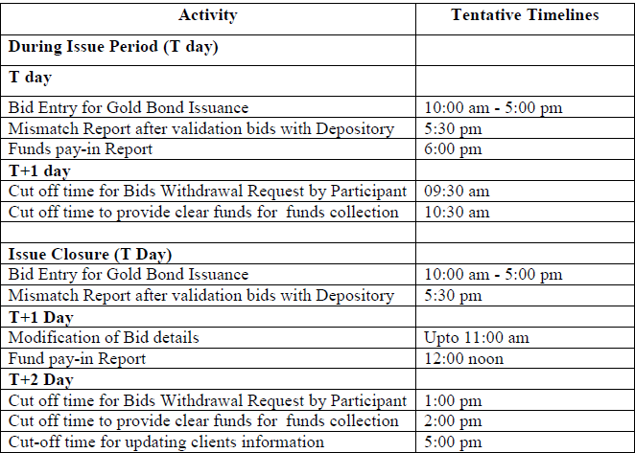
Activity Timing

Slide 4
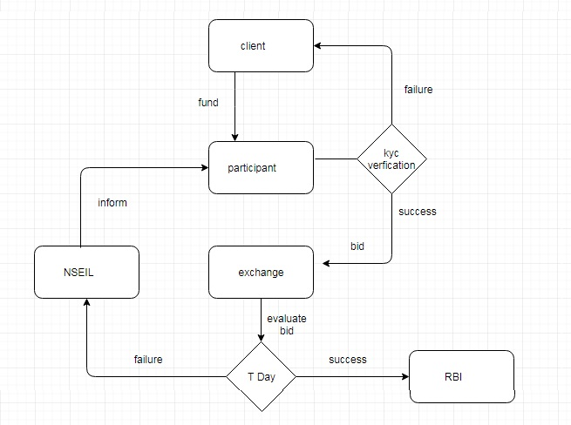
Existing Flow

Slide 5
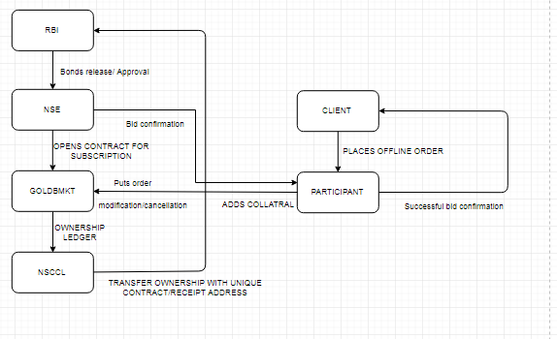
T+1 day

Slide 6
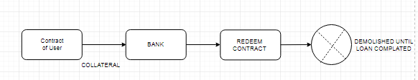
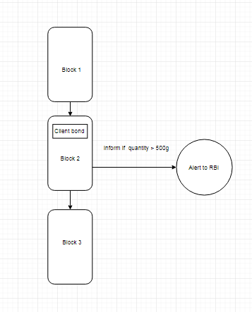
Integrated Use Cases

Slide 7
Benefits of Implementation
Same prototype can be implemented for primary Market(IPO) , Mutual Funds NFO.
Blockchain can make primary market activities much more optimal through decentralized database.
Transparency and Auditability in Regulatory purpose is significantly improved.
End to End time processing is significantly reduced.

Slide 8
THANK YOU
Notes:
‹#›

